Slide 1
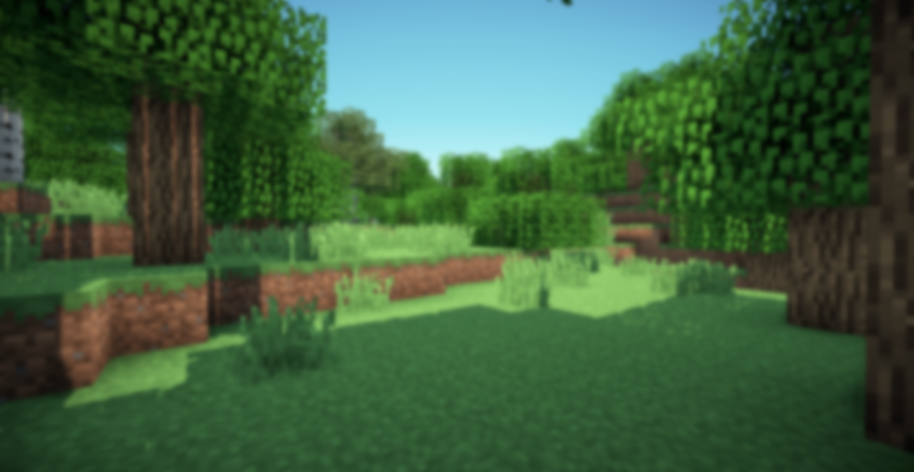
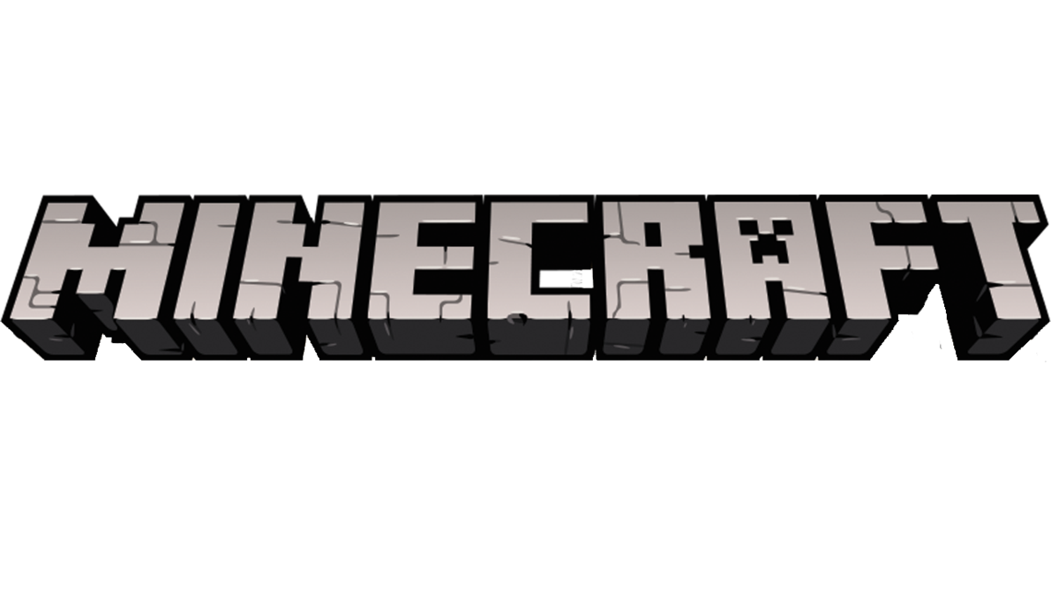
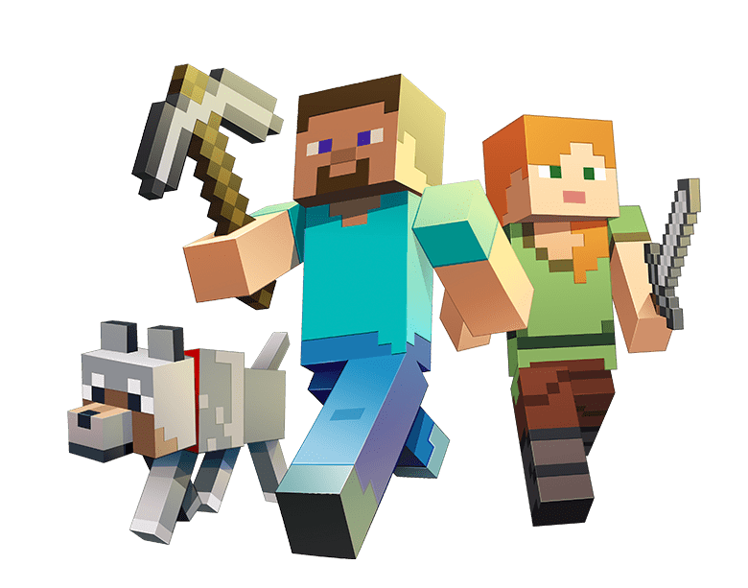
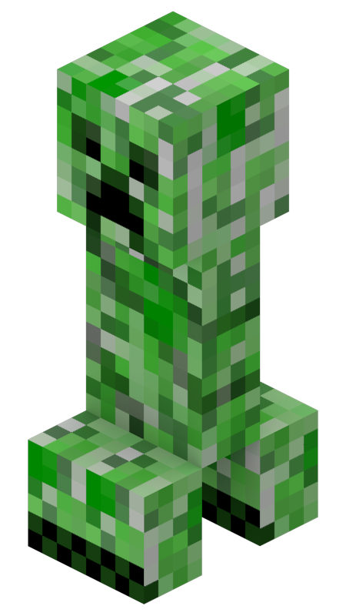
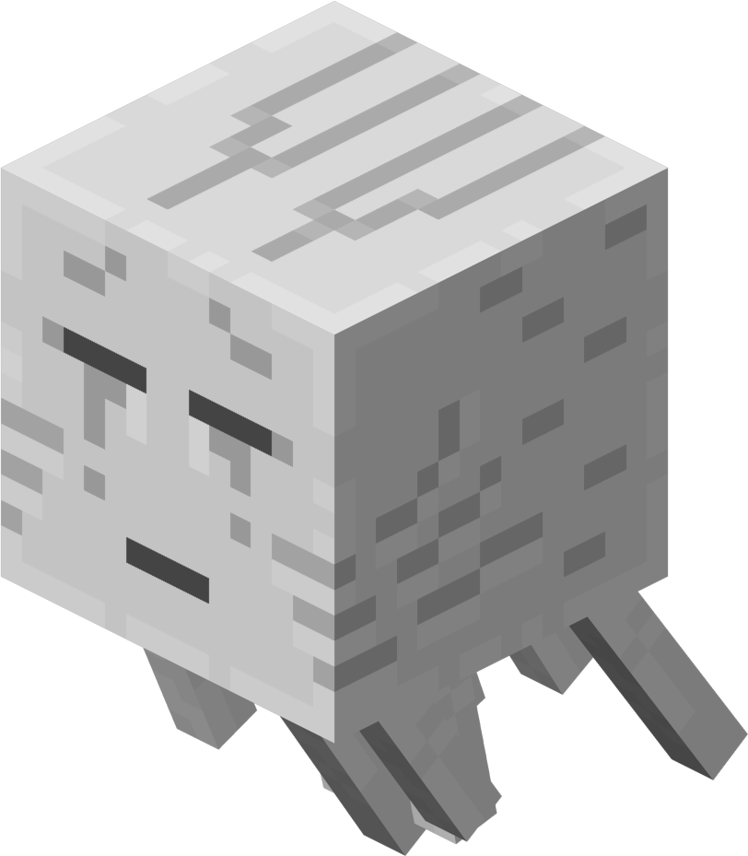
Start the Presentation
Options.
Quit
11.02.2024

Slide 2

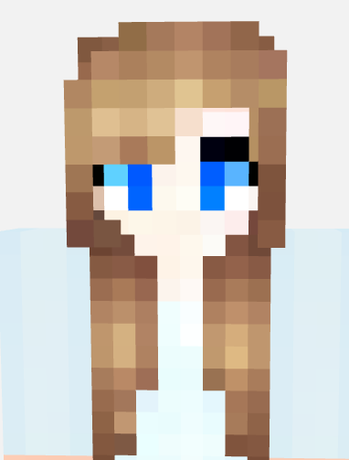



Our Team
Franziska Paulini
Lusil Ramaliu
Julia Ungefug
Erkaiym
Uselmann

Slide 3

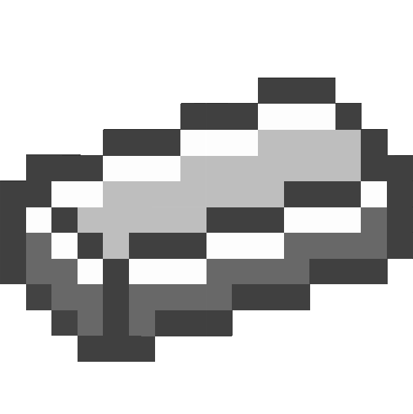

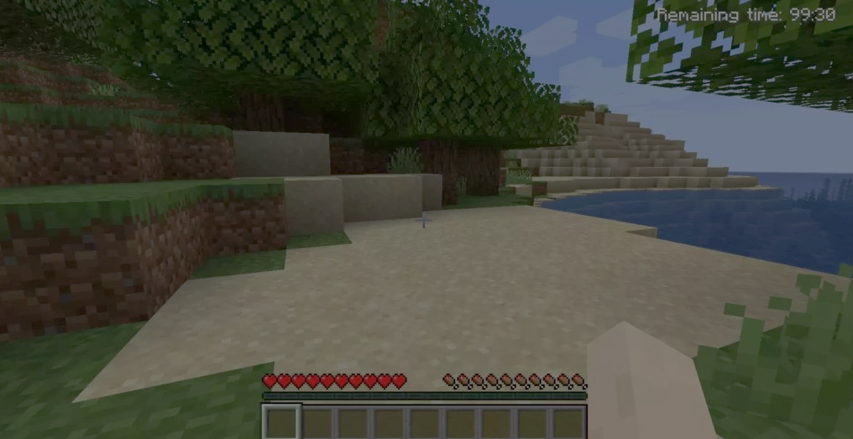
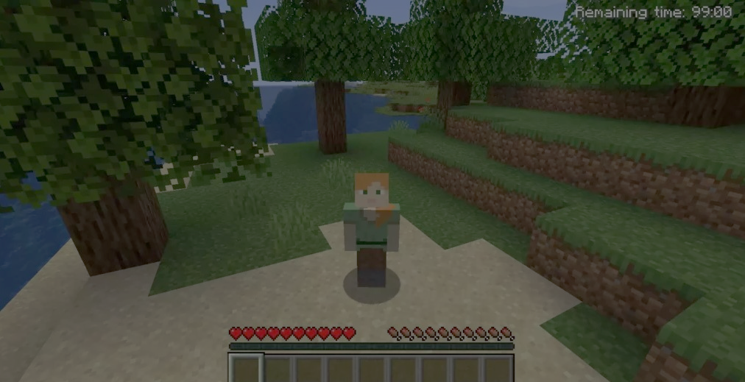
AGENDA
Problem/Motivation
Research Question
Theoretical Background
Study Design
Survey
Results
Discussion
8.Theoretical and Practical Contribution
9.Reflection
10.Contribution

Slide 4
Reasons for choosing Minecraft:
Accessibility and Popularity
Long Existence with Continous Updates
Creative Freedom
Modding and Customization Options
Interactive and Social Elements
Low Technical Barrier
Loading……

Slide 5
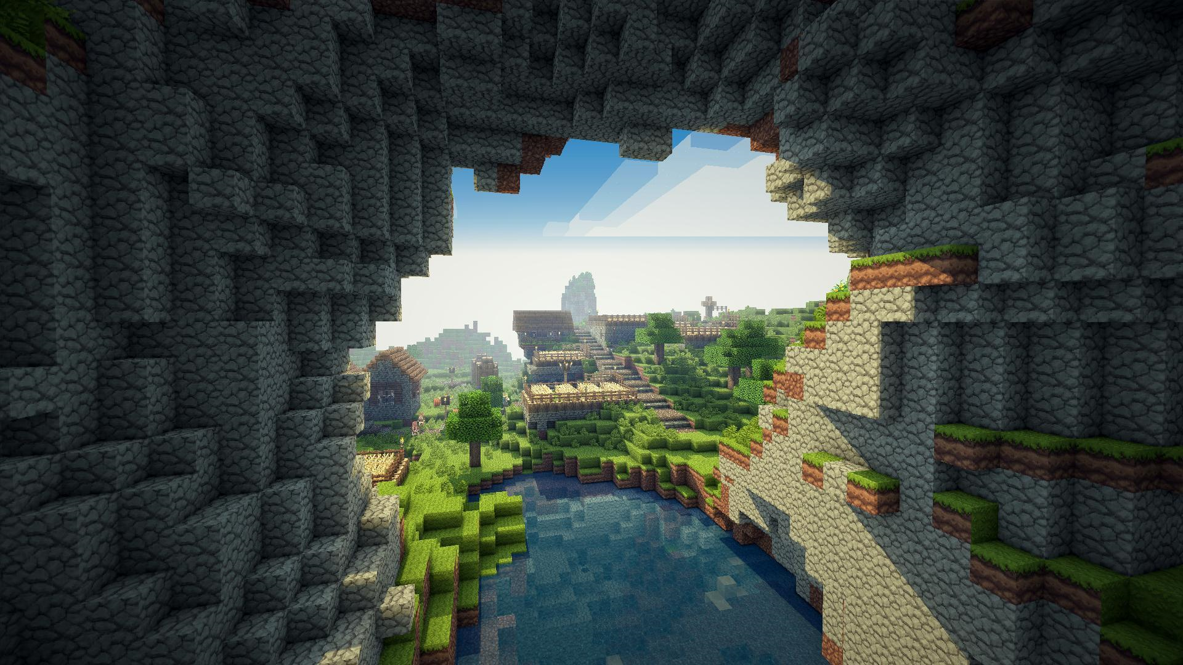
Problem/Motivation
Is the metaverse a relevant space for content creators?

Slide 6
Research Question
What motivates creators of the Metaverse? ​
A study on the effects of intrinsic need, satisfaction and​ external incentives​

Slide 7
Theoretical Background
Social Capital Theory
Uses and Gratifications Theory
Self-Determination Theory
Social Identity Theory

Slide 8
Theoretical Background
The Rise of the Creator Economy
Ethical Considerations and Challenges
Audience Engagement and Community Building
The Future of Content Creation

Slide 9

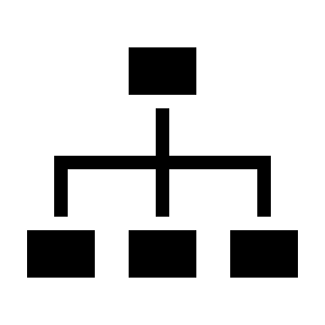

Study Design
Study Type and Purpose
Study Type: quantitative and descriptive
Focus: Motivation of content creators on the Metaverse
Participants: Minecraft content creators
Survey Structure
Duration: 68 items - approximately 10-15 minutes
Topics covered: Personal content creation habits, Motivational constructs, Demographic information
Measurement Tools: Likert scale (1–5) was used for most questions
Statistical Tools and Analysis
SmartPLS used for path-based partial least sqaures structural equation modeling
Metrics for reliability and validity included Cronbach’s alpha, composite reliability, and average variance extracted

Slide 10
Procedure of the Survey
Adaptation of survey on Limesurvey
Data Collec-tion
Data Preparation in Excel
Data Preparation in SmartPLS
Interpretation of results and comparison with existing study

Slide 11
Adaptation of the Survey on Limesurvey
Purpose
Tailor the survey to Minecraft's unique creator community
Add questions to clarify what qualifies a "content creator" in Minecraft
Key Changes
Platform-Specific Updates
Replaced references to Roblox with Minecraft
Content-Specific
Adjusted content types to reflect Minecraft's features
Constructions & Technical Constructions (e.g., buildings, cities)
Mods, plugins, texture packs, or skins

Slide 12






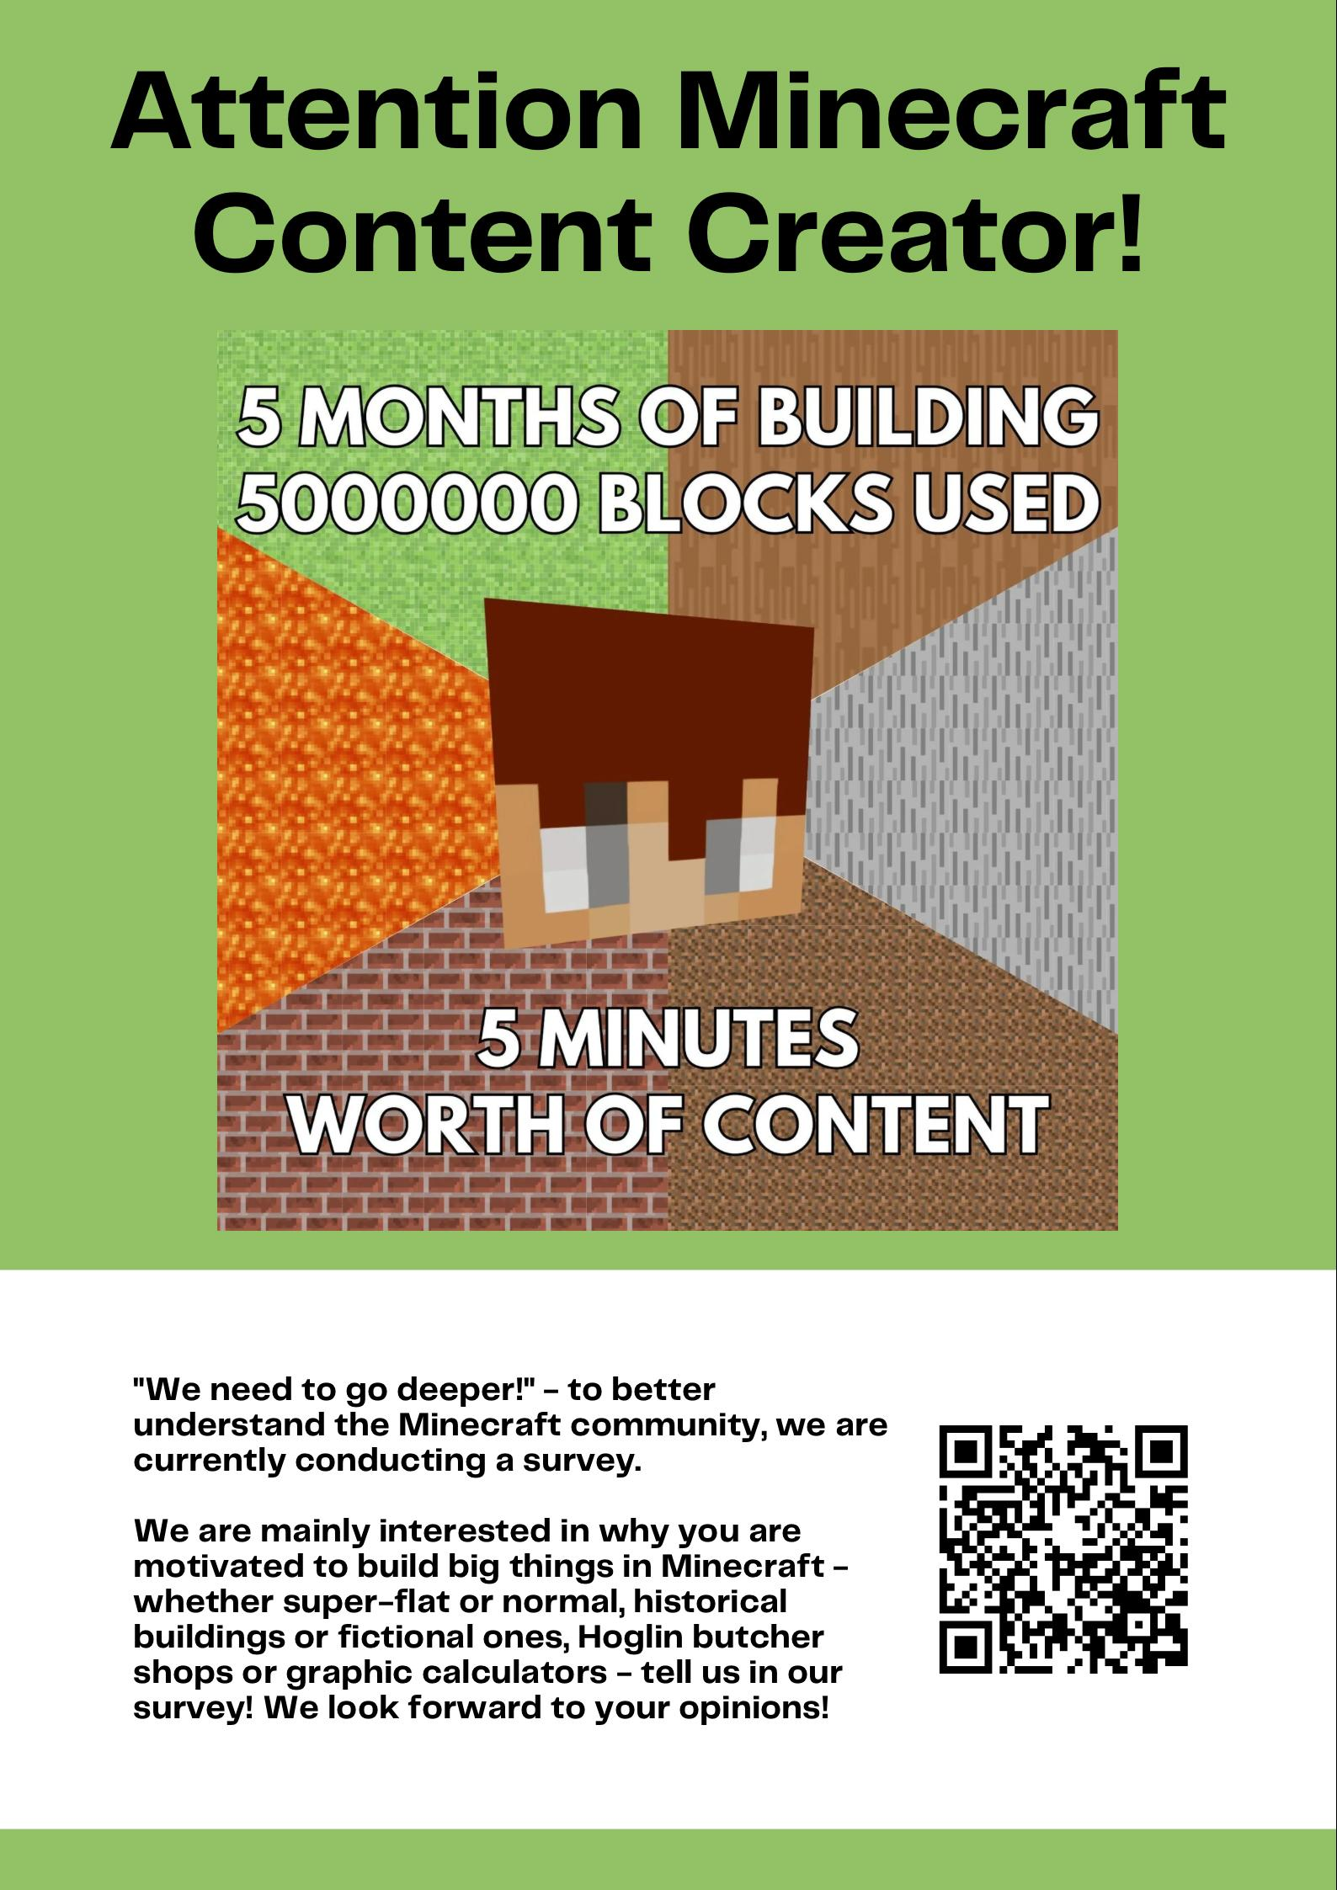


Data Collection
How many answers we got?
Completed totally: 122
Completed partially: 168
Total answers: 290
Problems
Trust issues with the survey link
Trust issues with our profiles
Large scope of survey & „repeated questions“
E-Mail to WiSo students via mailing list + poster

Slide 13


Data Preparation in Excel
Data Cleaning
Syntax Accuracy (Spelling of countries and text answers)
Removing non-serious answers
Selection of relevant columns and lines
Non relevant Columns:
Date and time of survey answering
Time to fill out
Last time of content creation
Deleted Instances:
Age <16 (n = 5)
Non Content Creator (n = 111)
Don’t share any content with others
Didn’t answer that questions (Randomization)
→ 163 left

Slide 14
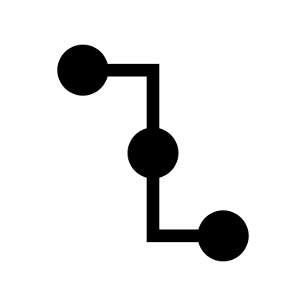
Data Preparation in SmartPLS
Selection of Columns/Attributes
Adding helping behavior
Dividing income into income and actual income
Missing values: marked as N/A
Leaving out country, age, gender → not part of model
Formative variables
Specifying data types:
Data type: Likert scale questions (ordinal), income and age (metric/numeric), gender (categorical)
Minimum and maximum specified
7) Resulting Structual equation model

Slide 15
Overall Motivation - Hypotheses
H1: Overall internal motivation examined in this research are positively associated with average time invested weekly for Minecraft.
H2: Overall internal motivation examined in this research are positively associated with intention to continue to create content for Minecraft.
H3: Overall internal motivation examined in this research are positively associated with word of mouth.
H4: Overall external motivation examined in this research are positively associated with average time invested weekly for Minecraft.
H5: Overall external motivation examined in this research are positively associated with intention to continue to create content for Minecraft.
H6: Overall internal motivation examined in this research are positively associated with word of mouth

Slide 16
Overall Motivation - Hypotheses
H1, H2, H3: Internal motivation significantly influence time invested, intention to continue, and word of mouth (p < 0.10)
NOT REJECTED
H4: External motivation significantly influence time invested (p < 0.10)
NOT REJECTED
H5, H6: External motivation do not significantly influence intention to continue or word of mouth
(p > 0.10)
REJECTED

Slide 17
Internal Motivation
Cognitive
needs
Skill Development
Information
Dissemination
Affective
needs
Enjoyment
Self-Expression
Personal integrative
needs
H1
0.157*
Avarage Time Invested Weekly
R²= 0.179
Social integrative
needs
H2
Social Interaction: Keep Contact
0.566***
H3
Social Interaction: Make Contact
0.532***
Sense of Community
Intention to Continue Creating Content
R²= 0.353
Helping Behavior
Tension release
needs
0.336*
Escapism
H4
Passing Time
H5
Word of Mouth
R²= 0.365
External Motivation
External economic
incentives
H6
Income
External social
incentives
Reputation
Long-term extrinsic
incentives
Professional advancement
90 % Significance Level
‘ = p < 0.100
* = p < 0.050
** = p < 0.010
*** = p < 0.001
Actual Income

Slide 18
Data Analysis in SmartPLS
Validity and Reliability Overall Motivation:
Cronbach‘s Alpha
Composite reliability
Average variance extracted (AVE)
Fornell-Larcker criterion: not fulfilled for internal motivation
Heterotrait-monotrait (HTMT): discriminant validity
 | Cronbach's alpha | Composite reliability | Average variance extracted (AVE)
External Motivation | 0.917 | 0.920 | 0.550
Internal Motivation | 0.946 | 0.951 | 0.346
Intention to Continue Creating Content | 0.829 | 0.851 | 0.747
Word of Mouth | 0.756 | 0.760 | 0.672

Slide 19
Data Analysis in SmartPLS
Internal motivation significantly boost content creation and word of mouth.
External motivation mainly increase time invested but have no effect on continuance or word of mouth.
 | Average Time Invested Weekly |  |  | Intention to Continue Creating Content |  |  | Word of Mouth
 | R2 = 0.179 |  |  | R2 = 0.354 |  |  | R2 = 0.365
 | β | p | Confidence interval | β | p | Confidence interval | β | p | Confidence interval
Internal Motivation | 0.157* | 0.037 | 0.055 - 0.299 | 0.566*** | 0.000 | 0.441 - 0.706 | 0.532*** | 0.000 | 0.381 - 0.684
External Motivation | 0.336** | 0.002 | 0.139 - 0.490 | 0.064 | 0.484 | -0.093 - 0.207 | 0.113 | 0.237 | -0.043 - 0.271
90 % Significance Level
‘ = p < 0.100
* = p < 0.050
** = p < 0.010
*** = p < 0.001

Slide 20
Cognitive
needs
Skill Development
Information
Dissemination
0.313*
Affective
needs
Enjoyment
0.291*
Self-Expression
Personal integrative
needs
Avarage Time Invested Weekly
R²= 0.231
Social integrative
needs
0.221'
Social Interaction: Keep Contact
-0.156*
Social Interaction: Make Contact
Sense of Community
0.233*
Helping Behavior
Intention to Continue Creating Content
R²= 0.494
0.264**
Tension release
needs
Escapism
-0.166'
Passing time
0.181'
External economic
incentives
Word of Mouth
R²= 0.468
Income
Actual Income
0.186'
External social
incentives
Reputation
90 % Significance Level
‘ = p < 0.100
* = p < 0.050
** = p < 0.010
*** = p < 0.001
0.227*
Long-term extrinsic
incentives
Professional advancement

Slide 21
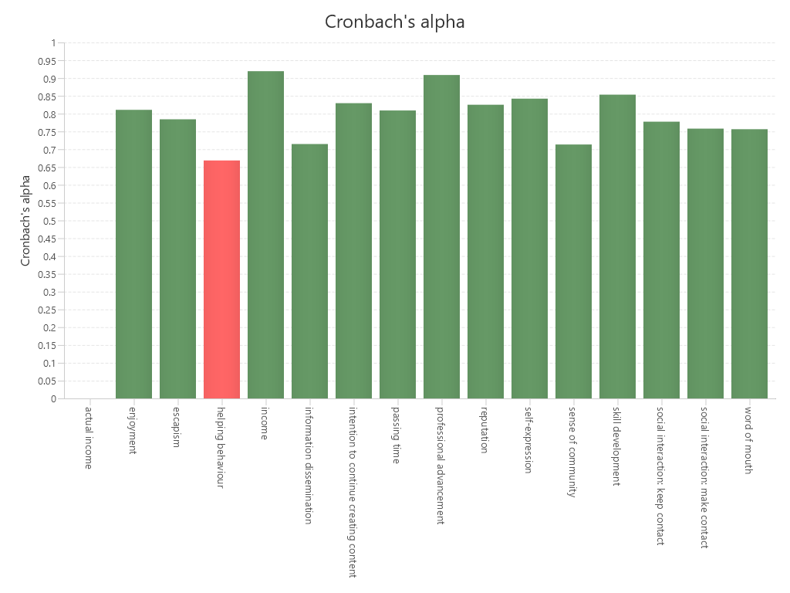
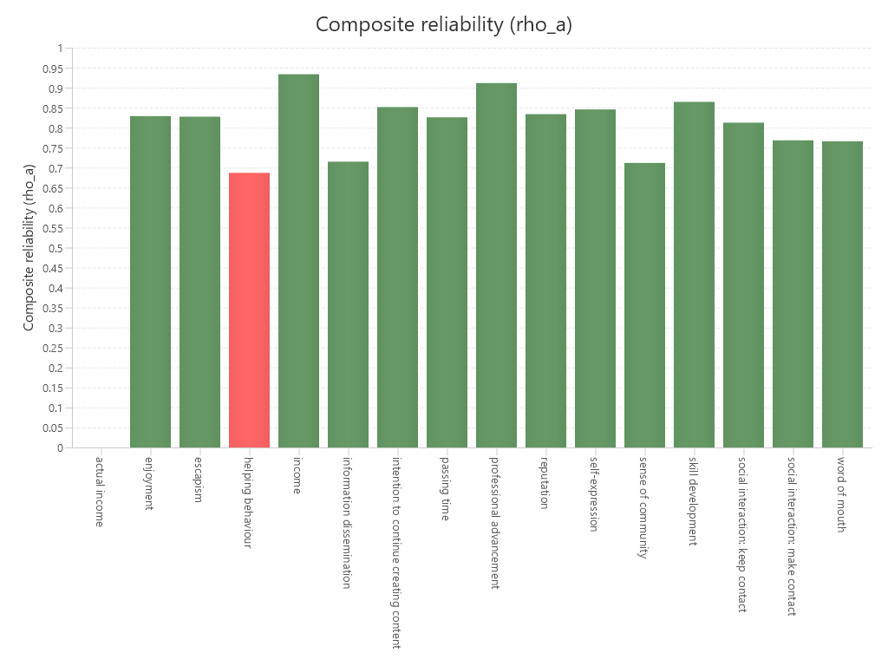
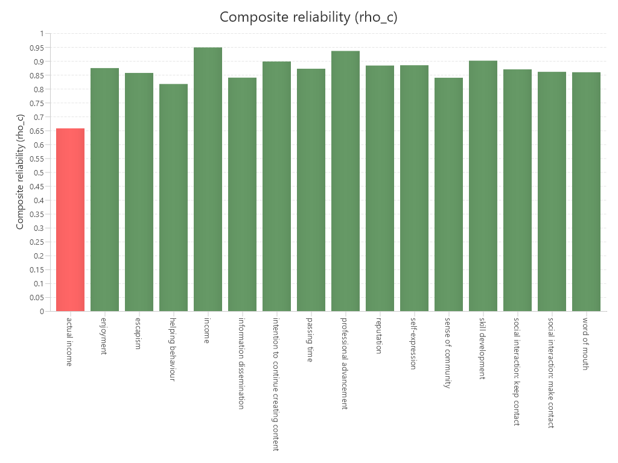
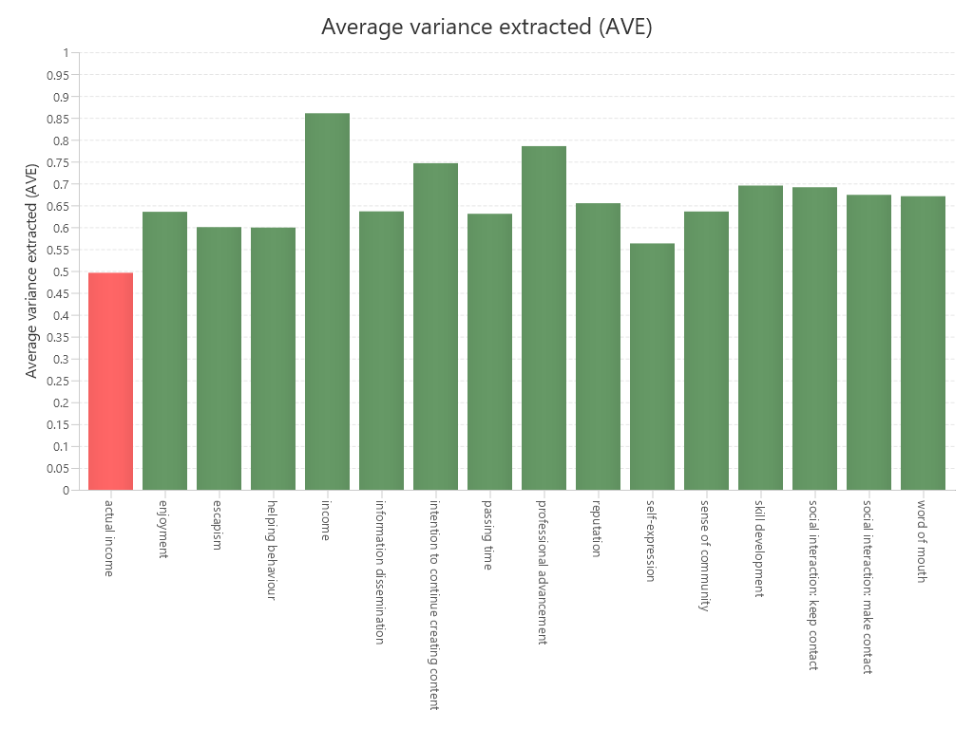
Data Analysis in SmartPLS
Validity and Reliability Specific Motivations:
Cronbach‘s Alpha
Composite reliability
Average variance extracted (AVE)
Fornell-Larcker criterion:
discriminant validity
Helping behaviour
Actual income

Slide 22
Data Analysis in SmartPLS
 | Average Time Invested Weekly |  |  | Intention to Continue Creating Content |  |  | Word of Mouth
 | R2 = 0.231 |  |  | R2 = 0.494 |  |  | R2 = 0.468
 | β | p | Confidence interval | β | p | Confidence interval | β | p | Confidence interval
1. Skill Development | 0.104 | 0.485 | -0.138 - 0.349 | 0.313* | 0.009 | 0.101 - 0.502 | 0.291* | 0.014 | 0.082 - 0.470
2. Information Dissemination | -0.161 | 0.426 | -0.442 - 0.215 | -0.082 | 0.429 | -0.243 - 0.095 | -0.109 | 0.313 | -0.289 - 0.063
3. Enjoyment | 0.127 | 0.359 | -0.111 - 0.341 | 0.146 | 0.179 | -0.020 - 0.341 | -0.014 | 0.901 | -0.182 - 0.177
4. Self Expression | 0.036 | 0.850 | -0.251 - 0.362 | 0.221' | 0.090 | -0.011 - 0.416 | -0.020 | 0.871 | -0.213 - 0.191
5. Social Interaction: Keep Contact | -0.104 | 0.352 | -0.294 - 0.073 | -0.156* | 0.055 | (-0.279) - (-0.007) | 0.080 | 0.400 | -0.073 - 0.238
6. Social Interaction: Make Contact | 0.121 | 0.192 | -0.045 - 0.261 | -0.060 | 0.607 | -0.254 - 0.137 | -0.059 | 0.554 | -0.217 - 0.112
7. Sense of Community | -0.116 | 0.328 | -0.318 - 0.068 | 0.123 | 0.271 | -0.075 - 0.292 | 0.264** | 0.010 | 0.073 - 0.407
8. Passing Time | -0.011 | 0.937 | -0.243 - 0.214 | 0.079 | 0.382 | -0.075 - 0.224 | 0.181' | 0.069 | 0.013 - 0.345
9. Escapism | -0.072 | 0.604 | -0.306 - 0.148 | 0.007 | 0.934 | -0.113 - 0.171 | -0.166' | 0.080 | -0.310 - 0.000
10. Income | 0.040 | 0.750 | -0.185 - 0.228 | 0.141 | 0.239 | -0.069 - 0.326 | -0.120 | 0.199 | -0.265 - 0.043
11. Actual income | -0.143 | 0.108 | -0.235 - 0.065 | -0.041 | 0.420 | -0.112 - 0.054 | 0.065 | 0.277 | -0.049 - 0.146
12. Reputation | 0.101 | 0.508 | -0.158 - 0.338 | -0.152 | 0.156 | -0.319 - 0.030 | 0.022 | 0.847 | -0.149 - 0.226
13. Professional Advancement | 0.186' | 0.08 | -0.005 - 0.344 | 0.036 | 0.812 | -0.217 - 0.286 | 0.227* | 0.046 | -0.005 - 0.344
14. Helping Behavior | 0.233* | 0.050 | 0.033 - 0.421 | 0.184 | 0.137 | -0.023 - 0.383 | 0.204 | 0.115 | -0.006 - 0.418
Skill development and professional advancement drive content creation and word of mouth.
Helping behavior increases time spent; reputation boosts word of mouth.
Actual income reduces time spent, while escapism marginally encourages content creation.
90 % Significance Level
‘ = p < 0.100
* = p < 0.050
** = p < 0.010
*** = p < 0.001

Slide 23
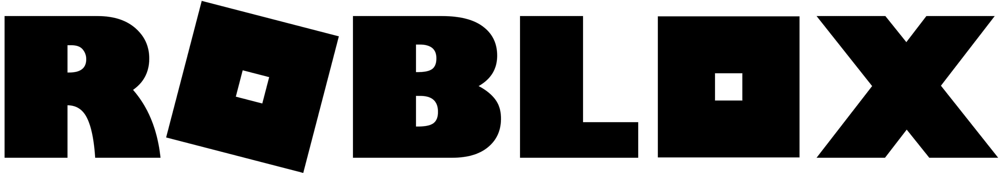

Comparison of &
Overall Motivation
Internal Motivation
Content Contribution
Internal Motivation
0.157*
Average Time Invested Weekly
0.566***
0.445***
0.532***
Intention to Continue Creating Content
External Motivation
Continuance Intention
0.336**
External Motivation
Word of Mouth
95 % Significance Level
* = p < 0.050
** = p < 0.010
*** = p < 0.001
90 % Significance Level
* = p < 0.050
** = p < 0.010
*** = p < 0.001

Slide 24
Comparison of &
Overall Motivation
Significant correlation between Continuance Intention and Internal Motivation (***) for &
-> Internally motivated creators are more likely to continue to
create content.
-> External motivation seems to play a subordinate role.
Significant correlation between Average Time Invested Weekly and both Internal (*) and External Motivation (**) for
-> Both internal and external motivation seem to influence
the amount of time creators invest.
Significant correlation between Word of Mouth and Internal Motivation (***) for
-> Internally motivated creators are more likely to recommend.
-> External motivation seems to play a subordinate role.

Slide 25
Comparison of &
Specific Motivation
Internal Motivation
Skill Development
Enjoyment
0.313*
Average Time Invested Weekly
Internal Motivation
…
Content Contribution
Social Interaction: Keep Contact
0.281**
-0.156*
Passing Time
0.210**
Intention to Continue Creating Content
Sense of Community
0.291*
External Motivation
Income
0.185*
0.233*
0.264**
Helping Behavior
…
Word of Mouth
Continuance Intention
…
Status and Recognition by Others
0.148*
External Motivation
0.227*
Professional Advancement
95 % Significance Level
* = p < 0.050
** = p < 0.010
*** = p < 0.001
90 % Significance Level
* = p < 0.050
** = p < 0.010
*** = p < 0.001
…

Slide 26
Significant Correlation between
Continuance Intention and…
(+) Enjoyment (**)
(+) Passing Time (*)
(+) Status and Recognition by
others (*)
(+) Skill Development (*)
(-) Social Interaction: Keep
Contact (*)
Creators who find enjoyment in content creation and use it as a way to relax or pass the time are more likely to continue creating content.
Status and recognition by others seem to influence continuance intention, likely due to the young age of Roblox creators.
Creators seem to prefer working alone instead of collaborating on projects.
Creators seem to continue creating content to develop their skills.
-> Modding, Redstone:
opportunity to create complex content
Creators who are motivated by social interaction seem to be more focused on engaging with others rather than continuing to create content.
-> Huge Minecraft community
-> Minecraft as a social
platform

Slide 27
Significant Correlation between Content
Contribution/Average Time Invested Weekly and…
(+) Income (**)
(+) Helping Behavior (*)
Creators appear to be motivated by the prospect of earning extra income, such as the opportunity to accumulate Robux.
Content contribution seems to be encouraged by altruistic behaviour.

Slide 28
Significant Correlation between
Word of Mouth and…
(+) Social Interaction: Keep Contact (*)
(+) Sense of Community (*)
(+) Professional Advancement (*)
Creators who use Minecraft as a social platform appear to be more likely to recommend content creation for Minecraft.
Creators who create content to benefit professionally appear more likely to reccomend content creation for Minecraft.

Slide 29
Theoretical Implications
Internal motivation sustains long-term content creation, while external motivation only increases time investment
Strong association with Content Continuation and Word of Mouth
-> Supports Self-Determination Theory
Helping Behavior increases time spent
-> Supports Social Capital Theory
Internal motivation (Skill Development, Self-Expression, Professional Growth) drives Engagement and Word of Mouth
-> Supports the UGT Theory

Slide 30
Theoretical Implications
UGT Theory doesn't fully differentiate between passive engagement (playing for fun) and active engagement (creating content for a purpose)
Casual players -> driven by escapism and entertainment (short-term)
Active Minecraft content creator -> not just consuming but producing content (long-term)
UGT may need to be expanded or modified to include "skill-based gratification", which is a key factor for the content creators

Slide 31
Practical Implications
Let's go to watch "A Minecraft Movie" :)
"A Wonderland where anything you
can imagine is possible"

Slide 32
Practical Implications
Self-Expression & Creativity: Creative Freedom
Skill Development & Learning Progression: Learning modules
Social & Community Driven Engagements: Shared building spaces
Purpose-Driven Content creation: World-building projects
Financial & Non-financial incentives
Addressing negative influences on Engagement: Escapism
Is the metaverse a relevant space for content creators?

Slide 33
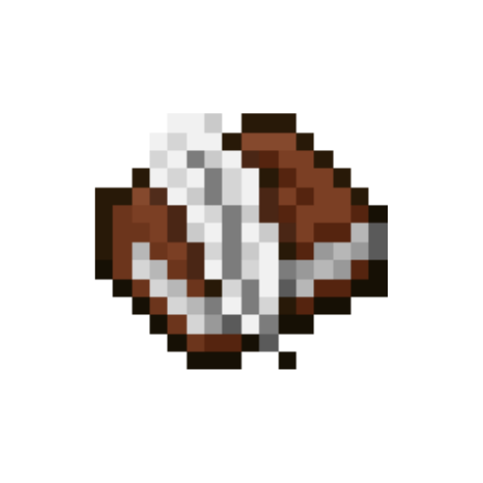
Reflection
Limitations of study
Small number of participants
Participants invest different efforts in creating (very detailed vs. Simpler)
Filtering: Randomization of questions
Problems with data collection
Comparison with Roblox study harder because model was not exactly the same
Fictious answers
Nice people and meaningful connections
People felt seen

Slide 34
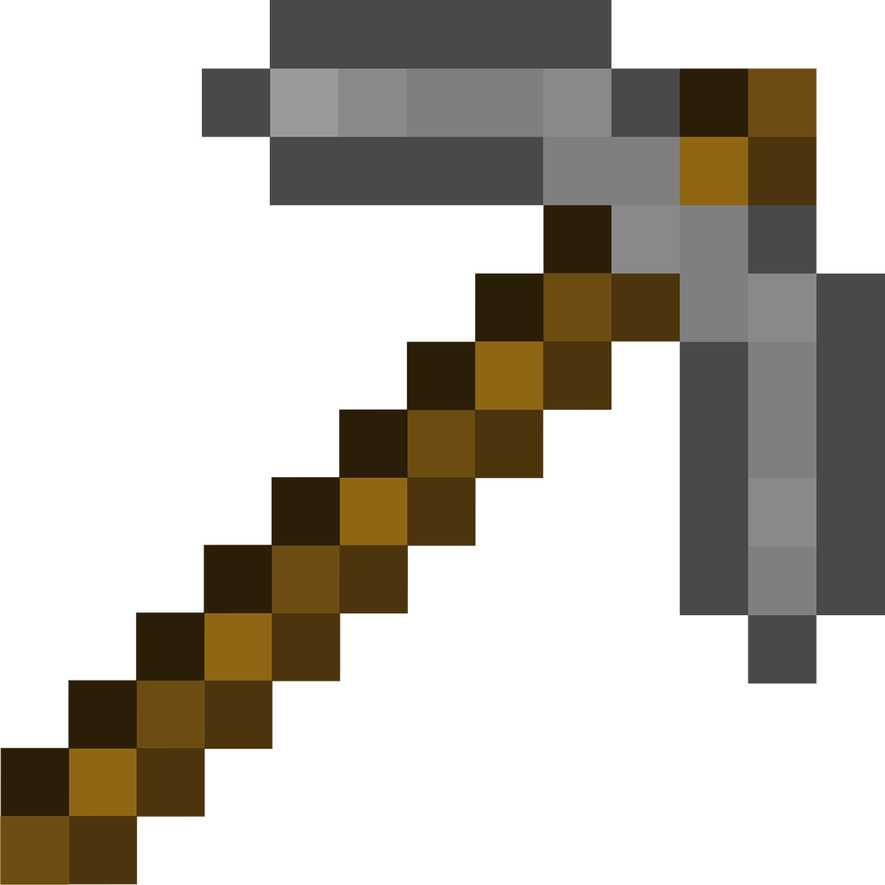
Contribution
Collectively:
Adaptation of survey on Limesurvey
Data Collec-tion
Data Prepara-tion in Excel
Data Preparation in SmartPLS
Interpretation of results and comparison with existing study
!
Individually:
Each of us used a different platform:
Theoretical: Lusil and Erkaiym
Roblox: Franziska and Julia

Slide 35
THANK
YOU
Quit
Start Q&A

Slide 36
Appendix

Slide 37
Data Preparation in Excel (Backup)
Disregarding the following columns

Slide 38
Data Preparation in Excel (Backup)
Classification Content Creator

Slide 39
Descriptive Statistics
Mean and variance actual income
mean of your data is 650.76
Variance ​= 21149062.42 (because of high values like 5843 and 17868)
Notes:
Average Time Invested Weekly (R² = 0.179)
Helping Behaviour: Positive significant effect (β = 0.233, p = 0.050
Professional Advancement: Positive significant effect (β = 0.186, p = 0.030)
Actual Income: Negative significant effect (β = -0.143, p = 0.014)
Intention to Continue Creating Content (R² = 0.484)
Skill Development: Positive significant effect (β = 0.313, p = 0.009).
Self-Expression: Positive significant effect (β = 0.221, p = 0.020).
Social Interaction (Keep Contact): Negative significant effect (β = -0.156, p = 0.050).
Word of Mouth (R² = 0.466)
Skill Development: Positive significant effect (β = 0.291, p = 0.014).
Sense of Community: Positive significant effect (β = 0.268, p = 0.009).
Professional Advancement: Positive significant effect (β = 0.227, p = 0.040).
Escapism: Negative significant effect (β = -0.166, p = 0.040).

Slide 40

Data Analysis in SmartPLS
Analysis
Path coefficient, p-value, confidence interval extracted from SmartPLS
Reliability & validity:
Composite reliability (rho_a)

Slide 41
Data Analysis in SmartPLS
Validity and Reliability Higher Level:
Fornell-Larcker criterion: the square root of AVE for each variable (the top number in any constructs column) is higher than the variance it shares with any other variable (all numbers below the top number)
HTMT: All values below 0,9
 | External Motivators | Internal Motivation | Average Time Invested Weekly | Intention to Continue Creating Content | Word of Mouth
External Motivator | 0.741
Internal Motivation | 0.516 | 0.588
Average Time Invested Weekly | 0.365 | 0.301 | 1.000
Intention to Continue Creating Content | 0.342 | 0.591 | 0.198 | 0.864
Word of Mouth | 0.395 | 0.595 | 0.173 | 0.494 | 0.820
 | HTMT
Internal Motivation <-> External Motivaton | 0,566
Aaverage Time Invested Weekly <-> External Motivaton | 0,377
Average Time Invested Weekly <-> Internal Motivation | 0,300
Intention to Continue Creating Content <-> External Motivaton | 0,391
Intention to Continue Creating Content <-> Internal Motivation | 0,639
Intention to Continue Creating Content <-> Average Time Invested Weekly | 0,219
Word of Mouth <-> External Motivation | 0,469
Word of Mouth <-> Internal Motivation | 0,687
Word of Mouth <-> Average Time Invested Weekly | 0,200
Word of Mouth <-> Intention to Continue Creating Content | 0,617
Henseler et al. (2015)

Slide 42
Data Analysis in SmartPLS
the square root of AVE for each variable (the top number in any constructs column) is higher than the variance it shares with any other variable (all numbers below the top number).
Fornell-Larcker criterion
 | actual income | average time invested weekly | enjoyment | escapism | helping behaviour | income | information dissemination | intention to continue creating content | passing time | professional advancement | reputation | self-expression | sense of community | skill development | social interaction: keep contact | social interaction: make contact | word of mouth
actual income | 0,704
average time invested weekly | -0,054 | 1,000
enjoyment | 0,042 | 0,262 | 0,797
escapism | 0,130 | 0,027 | 0,321 | 0,775
helping behaviour | 0,093 | 0,329 | 0,486 | 0,293 | 0,774
income | 0,320 | 0,233 | 0,048 | -0,028 | 0,252 | 0,928
information dissemination | 0,103 | 0,226 | 0,530 | 0,268 | 0,627 | 0,257 | 0,798
intention to continue creating content | 0,062 | 0,198 | 0,500 | 0,299 | 0,465 | 0,198 | 0,433 | 0,864
passing time | 0,107 | 0,043 | 0,557 | 0,555 | 0,348 | -0,144 | 0,308 | 0,352 | 0,794
professional advancement | 0,228 | 0,339 | 0,205 | 0,127 | 0,372 | 0,647 | 0,390 | 0,301 | -0,089 | 0,886
reputation | 0,213 | 0,343 | 0,473 | 0,288 | 0,590 | 0,472 | 0,574 | 0,360 | 0,216 | 0,609 | 0,809
self-expression | 0,194 | 0,266 | 0,608 | 0,521 | 0,681 | 0,180 | 0,634 | 0,532 | 0,491 | 0,409 | 0,643 | 0,750
sense of community | 0,131 | 0,158 | 0,580 | 0,437 | 0,570 | 0,144 | 0,525 | 0,468 | 0,440 | 0,272 | 0,464 | 0,609 | 0,798
skill development | 0,085 | 0,329 | 0,665 | 0,314 | 0,566 | 0,278 | 0,702 | 0,583 | 0,364 | 0,480 | 0,577 | 0,628 | 0,559 | 0,834
social interaction: keep contact | 0,110 | 0,119 | 0,369 | 0,224 | 0,542 | 0,161 | 0,335 | 0,165 | 0,315 | 0,226 | 0,400 | 0,423 | 0,437 | 0,267 | 0,832
social interaction: make contact | 0,190 | 0,308 | 0,587 | 0,246 | 0,622 | 0,352 | 0,596 | 0,397 | 0,307 | 0,393 | 0,599 | 0,574 | 0,586 | 0,608 | 0,485 | 0,821
word of mouth | 0,141 | 0,173 | 0,459 | 0,207 | 0,525 | 0,167 | 0,423 | 0,496 | 0,347 | 0,370 | 0,435 | 0,486 | 0,536 | 0,550 | 0,373 | 0,442 | 0,819

Slide 43
Comparison between
&
Gameplay | Focus on game creation Robust set of development tools Single- and multiplayer mode | Focus on survival, exploration and creative building Limited set of development tools Single- and multiplayer mode
Educational Value | Teaches Lua, game development, 3D model, marketing and teamwork | Teaches Java, engineering and logic via Redstone, teamwork and STEM concepts
Monetization | Robust virtual economy with in-game purchases, earning and spending („Robux“) | Fewer in-game purchases compared to Roblox („Minecoins“)
Accessibility | Windows, MacOS, Android, iOS, Xbox, Meta Quest, PlayStation, Chrome OS | Windows, MacOS, Linux, iOS, Android, Xbox, ChromeOS, Amazon tablet, Nintendo Switch, PlayStation, Raspberry Pi
Cost | Free version available Premium subscription: $4.99-$19.99/month | Java Edition: $29.99 Bedrock Edition: $6.99-$19.99

Slide 44
Survey questions
Identification of content creators:
Do you mainly build content to play it yourself or to share it with others?
What kind of content do you create for Minecraft that others can use?
Passing time:
Creating content for Minecraft helps me pass the time.
Creating content for Minecraft gives me something to do.
Creating content for Minecraft relaxes me.
Creating content for Minecraft passes the time away when I'm bored.
Sense of community:
I feel like I'm surrounded by friendly people through my content creation activities within the Minecraft community.
I feel a sense of community through my content creation activities for Minecraft.
I feel a sense of belonging through my content creation activities in the Minecraft community.
Would you consider yourself as part of a building community?
Have you ever built or participated in a community or project?

Slide 45
Information dissemination:
Creating content for Minecraft enables me to provide information.
Creating content for Minecraft enables me to share information that might be useful to others.
Creating content for Minecraft enables me to share information about my special interests.
Professional advancement:
Creating content for Minecraft provides me with a means of developing my career.
Creating content for Minecraft can have a positive impact on my career options.
Creating content for Minecraft makes me being perceived better in the job market.
Creating content for Minecraft increases my chances of finding a job.
Skill development:
I think creating content for Minecraft develops my skills.
I learn new things through creating content for Minecraft.
I gain experience from creating content for Minecraft.
I can improve my personal abilities through creating content for Minecraft.

Slide 46
Enjoyment:
I find the experience of creating content for Minecraft enjoyable.
I find the experience of creating content for Minecraft pleasant.
I find the experience of creating content for Minecraft exciting.
I find the experience of creating content for Minecraft interesting.
Self-expression:
Creating content for Minecraft makes me feel good about myself.
Creating content for Minecraft plays a critical role in defining my self- concept.
Creating content for Minecraft serves me as an instrument of my self- expression.
Creating content for Minecraft helps me establish my self-identity.
Creating content for Minecraft helps me establish the kind of person I see myself to be.
Creating content for Minecraft helps me become the kind of person I see myself to be.

Slide 47
Escapism:
I can forget about school, work, or other things through my content creation activities.
I can get away from the rest of my family or others through my content creation activities.
I can get away from what I was currently doing through my content creation activities for Minecraft.
Creating content for Minecraft helps me escape from the reality.
Status and recognition by others:
My content creation activities for Minecraft improve my status.
My content creation activities for Minecraft make me feel important.
My content creation activities for Minecraft improve my reputation.
My content creation activities for Minecraft bring me fame.

Slide 48
Helping behavior:
I can show others encouragement through my content creation activities for Minecraft.
I can help others through my content creation activities for Minecraft.
I can let people know I care about them through my content creation activities for Minecraft.
Income:
My content creation activities for Minecraft enhance my economic situation.
My content creation activities for Minecraft lead to getting financial gains.
I gain extra income from my content creation activities for Minecraft.
My content creation activities for Minecraft benefit me financially.
Actual income:
On average, how much income do you make from content creation activities for Minecraft per month? (If you don't have an income enter 0)
On average, how many Minecoins do you make from contenct creation activities for Minecraft per month? (If you don't have an income enter 0)

Slide 49
Social interaction: keep contact:
I keep in touch with friends and family through creating content for Minecraft.
I communicate with distanced friends by creating content for Minecraft.
I keep in contact with friends through my content creation activities for Minecraft.
Social interaction: make contact:
Creating content for Minecraft is a great way to make new friends.
I meet new people through my content creation activities for Minecraft.
I make new acquaintances through my content creation activities for Minecraft.
Personal questions:
In which country do you live?
How old are you?
Which gender do you identify most with?
When did you start to create content for Minecraft?
Last time I created content for Minecraft.

Slide 50
Average time invested weekly:
On average, how many hours do you spend on creating content for Minecraft each week?
Intention to continue creating content:
I intend to continue creating content for Minecraft rather than discontinuing this.
I would like to continue creating content for Minecraft.
My intention is to continue creating content for Minecraft rather than to use any alternative means.
Word of mouth:
I will say positive things about creating content for Minecraft to other people.
I will recommend creating content for Minecraft to others who seek my advice.
I will refer my acquaintances to creating content for Minecraft.

